Slide 1
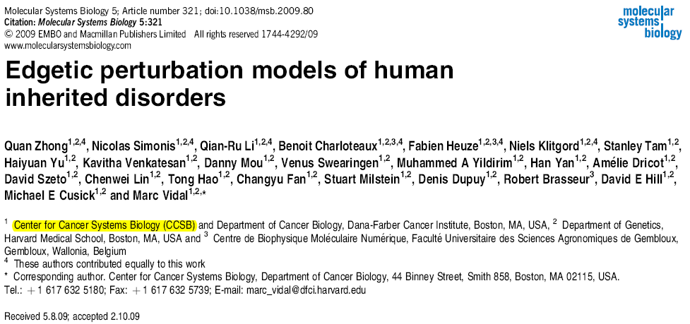
Zhen Shi June 2, 2010 Journal Club

Slide 2
Introduction
Most disease-causing mutations are thought to confer radical changes to proteins (Wang and Moult, 2001; Botstein and Risch, 2003; Yue et al, 2005; Subramanian and Kumar, 2006). Consequently, genotype-to-phenotype relationships in human genetic disorders are often modeled as: ‘mutation in gene X leads to loss of gene product X, which leads to disease A’. A single ‘gene-loss’ model seems pertinent for many diseases (Botstein and Risch, 2003). However, this model cannot fully reconcile with the increasingly appreciated prevalence of complex genotype-to-phenotype associations for even ‘simple’ Mendelian disorders (Goh et al, 2007), particularly in which:
(i) a single gene can be associated with multiple disorders (allelic heterogeneity),
(ii) a single disorder can be caused by mutations in any one of several genes (locus heterogeneity),
(iii) only a subset of individuals carrying a mutation are affected by the disease (incomplete penetrance),
or (iv) not all individuals with a given mutation are affected equally (variable expressivity).
More complex models to interpret genotype-to-phenotype relationshipswould probably improve the understanding of human disease.

Slide 3
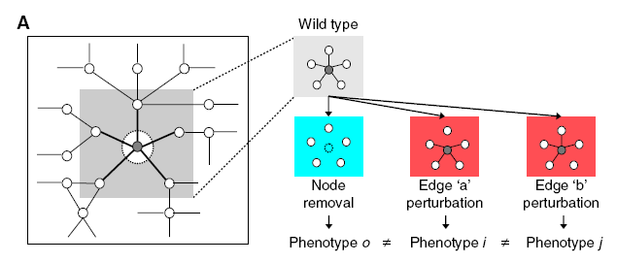
We hypothesize that distinct mutations causing distinct molecular defects to proteins may lead to distinct perturbations of cellular networks, giving rise to distinct phenotypic outcomes

Slide 4
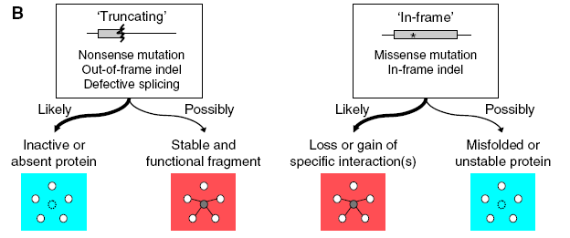
edgetic perturbation models
BASIS OF REASONING
‘truncating’ alleles are less prone to produce stably folded proteins than ‘in-frame’ alleles.

Slide 5
Truncating /
in frame
RESULT: Figure 2C
Autosomal dominant/ recessive
HYPOTHESIS TO TEST
‘truncating’ versus ‘in-frame’ alleles are enriched in distinct node removal versus edgetic perturbations, respectively.
PRESUMPTION:
autosomal dominant disease should be more frequently associated with edgetic perturbation than node removal (Figure 2B).
Node removal/ edge perturbation
Notes:
Figure 2C

Slide 6
Results
We examined ~50 000 Mendelian disease-causing alleles, affecting over 1900 protein-coding genes, altogether associated with more than 2000 human disorders available in the Human Gene Mutation Database (HGMD)
‘truncating’ alleles (47%)
‘in-frame’ alleles (53%)

Slide 7
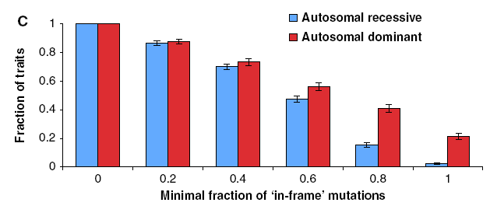
Truncating alleles contribute more to autosomal recessive disorder. Figure 2C

Slide 8
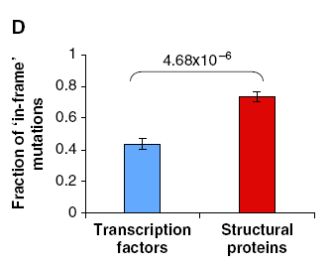
Distinct molecular mechanism of disease

Slide 9
Distinguishing edgetic perturbation from node removal
we used an integrated experimental approach to characterize binary protein interaction defects of disease-causing mutant alleles.
(i) Gateway recombinational cloning of mutations by PCR-based site-directed mutagenesis (Suzuki et al, 2005),
(ii) high-throughput mapping of binary protein–protein interactions (Rual et al, 2005),
(iii) high-throughput characterization of protein–protein interaction defects of all cloned disease causing mutant proteins, and
(iv) integration of network perturbations by disease-causing mutations with structural or functional information of disease proteins.
Notes:
Rual 2005: Systematic mapping of protein-protein interactions, or 'interactome' mapping, was initiated in model organisms, starting with defined biological processes and then expanding to the scale of the proteome. Although far from complete, such maps have revealed global topological and dynamic features of interactome networks that relate to known biological properties, suggesting that a human interactome map will provide insight into development and disease mechanisms at a systems level. Here we describe an initial version of a proteome-scale map of human binary protein-protein interactions. Using a stringent, high-throughput yeast two-hybrid system, we tested pairwise interactions among the products of approximately 8,100 currently available Gateway-cloned open reading frames and detected approximately 2,800 interactions. This data set, called CCSB-HI1, has a verification rate of approximately 78% as revealed by an independent co-affinity purification assay, and correlates significantly with other biological attributes. The CCSB-HI1 data set increases by approximately 70% the set of available binary interactions within the tested space and reveals more than 300 new connections to over 100 disease-associated proteins. This work represents an important step towards a systematic and comprehensive human interactome project.

Slide 10
Truncating /
in frame
RESULT: Figure 2C
Autosomal dominant/ recessive
HYPOTHESIS TO TEST
‘truncating’ versus ‘in-frame’ alleles are enriched in distinct node removal versus edgetic perturbations, respectively.
PRESUMPTION:
autosomal dominant disease should be more frequently associated with edgetic perturbation than node removal (Figure 2B).
Node removal/ edge perturbation
Notes:
Figure 2C

Slide 11
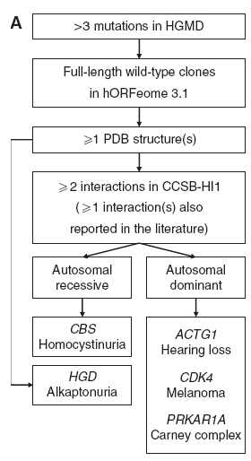
Data set
29 alleles associated with five
distinct genetic disorders

Slide 12
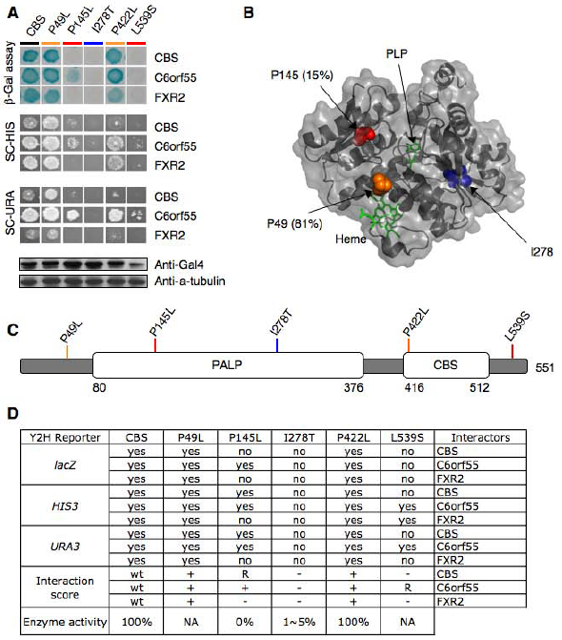
Interaction profile of mutants

Slide 13
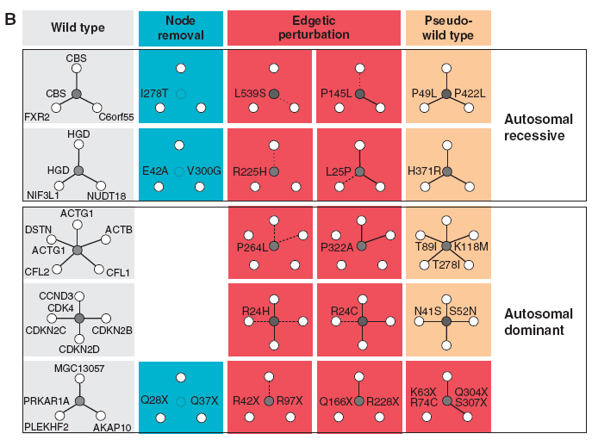

Slide 14
We related Y2H interaction profiles of each mutant to
structural properties of disease proteins (Supplementary
information and Supplementary Figure S2–6).
Grossly disruptive
mutations tend to affect buried residues of the protein,
whereas mutations leading to loss or gain of specific
interaction(s) tend to lie on the surface.

Slide 15
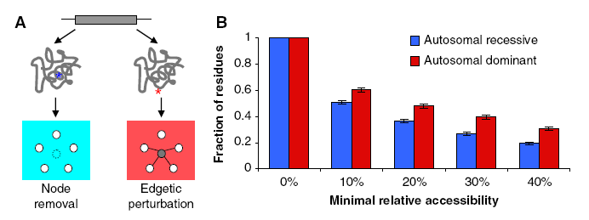
Structural analyses of disease-causing mutations
Among all 3664
affected residues in 236 proteins for which three-dimensional
X-ray structures are available

Slide 16
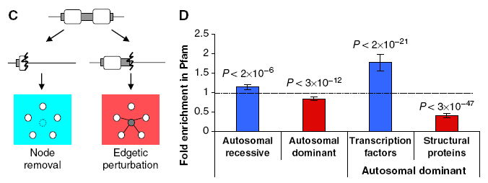
‘truncating’ mutations in autosomal
dominant disease are slightly depleted in Pfam domains,
whereas ‘truncating’ mutations in autosomal recessive disease
are slightly enriched in Pfam domains

Slide 17
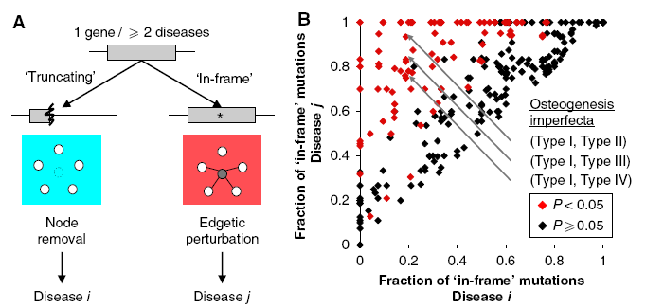
Node removal versus edgetic perturbation in complex gene-disease association
Distinct network perturbation models, leading to distinct phenotypic outcomes, predict that ‘truncating’ versus ‘in-frame’ alleles for a given gene product might cause different diseases (Figure 5A).
B: Each dot represents the fraction of ‘in-frame’ mutations of a pair of distinct diseases associated with a common gene.

Slide 18
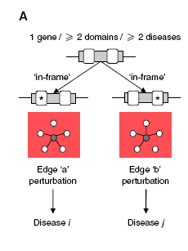
Edgetic perturbation models also predict that distinct edgetic perturbations for a given gene product might cause phenotypically distinguishable disorders (Figure 6A).
Among 169 genes associated with two or more diseases and encoding proteins containing at least two Pfam domains, 77 had significant enrichment of ‘in-frame’ mutations in Pfamdomains (P<0.05). Therewere nine proteinswith at least two Pfam domains significantly enriched with ‘inframe’ mutations (P<0.05).

Slide 19
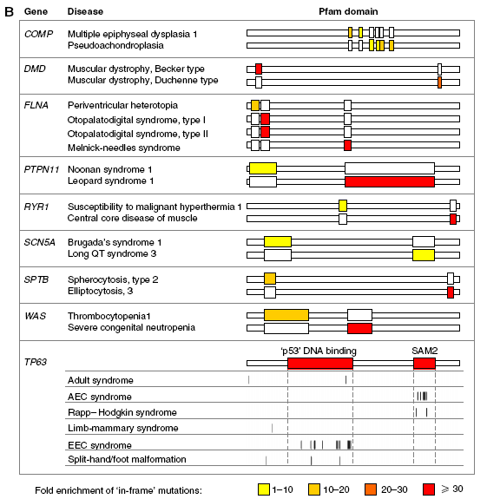

Slide 20
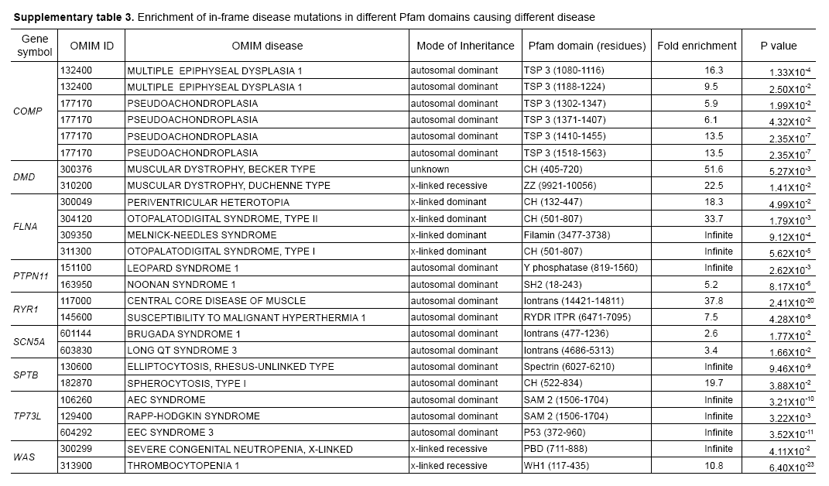

Slide 21
Conclusion
Experimental characterization of mutant alleles in various disorders identified diverse edgetic interaction profiles of mutant proteins, which correlated with distinct structural properties of disease proteins and disease mechanisms.
Edgetic perturbations seem to confer distinct functional consequences from node removal because a large fraction
of cases in which a single gene is linked to multiple disorders can be modeled by distinguishing edgetic network perturbations.

Slide 22
Limitations
First, the current interactome network derived from Y2H analysis is probably incomplete.
Second, Y2H detects binary protein interactions.
Third, Y2H is not quantitative.
Finally, disease mutations may affect protein functions by altering biochemical activities or protein–DNA or protein–RNA interactions.
Disease-associated alleles may also gain new interactions, which is another important potential mechanism for pathogenicity.

Slide 23
Prospect
Just as high-throughput sequencing technologies are revolutionizing genotyping platforms, and as functional genomics and proteomics are becoming increasingly able to characterize gene products resulting from whole genome sequencing and gene prediction, functional characterizations of genetic variations may be applied at large-scale to characterize mutations with uncertain pathological consequences.

