Slide 1
A single gene network accurately predicts phenotypic effects of gene perturbation in Caenorhabditis elegans
Insuk Lee1,4, Ben Lehner2,3,4, Catriona Crombie2, Wendy Wong2, Andrew G Fraser2 & Edward M Marcotte1

Slide 2
Abstract
The fundamental aim of genetics is to understand how an organism's phenotype is determined by its genotype, and implicit in this is predicting how changes in DNA sequence alter phenotypes. A single network covering all the genes of an organism might guide such predictions down to the level of individual cells and tissues. To validate this approach, we computationally generated a network covering most C. elegans genes and tested its predictive capacity. Connectivity within this network predicts essentiality, identifying this relationship as an evolutionarily conserved biological principle. Critically, the network makes tissue-specific predictions—we accurately identify genes for most systematically assayed loss-of-function phenotypes, which span diverse cellular and developmental processes. Using the network, we identify 16 genes whose inactivation suppresses defects in the retinoblastoma tumor suppressor pathway, and we successfully predict that the dystrophin complex modulates EGF signaling. We conclude that an analogous network for human genes might be similarly predictive and thus facilitate identification of disease genes and rational therapeutic targets.

Slide 3
The Niche
The central goal of genetics
“In coming decades, the number of individual human genomes sequenced will grow enormously, and the key emerging problem will be to correlate identified genomic variation to phenotypic variation in health and disease.”
“However, our present ability to predict the outcome of an inherited change in the activity of any single human gene is negligible.” ??
“A key goal of this network is that it should predict the phenotypic consequences of perturbing genes.”

Slide 4
Current flow chart
Gene function annotation
Integrated network
Works in unicellular organism (centrality and lethality)
How about metazoan?
Prediction of consequence of gene perturbation
functional genomics, proteomics and comparative genomics
Tissue, pleiotropy of gene

Slide 5
Gene annotation <-> integrated network - linkages between genes indicate their likelihood of being involved in the same biological processes
KEGG pathway annotations or (B) protein subcellular locations
A Probabilistic Functional Network of Yeast Genes. Science 26 November 2004

Slide 6
Constructing a proteome-scale gene network for C. elegans
DNA microarray measurements of the expression of C. elegans mRNAs (Supplementary Table 1 online),
assays of physical and/or genetic interactions (Supplementary Table 2 online) among C. elegans, fly, human, and yeast proteins,
literature-mined C. elegans gene associations, functional associations of yeast orthologs (we term such conserved functional linkages 'associalogs'),
estimates of the coinheritance of C. elegans genes across bacterial genomes,
and the operon structures of bacterial and/or archaeal homologs of C. elegans genes.

Slide 7
Dilemma in using these datasets
a naïve union of these datasets generates a large but error-prone network with poor predictive capacity.
although finding overlaps between multiple datasets identifies high-confidence linkages, it generates a low-coverage network that excludes much high-quality data.

Slide 8
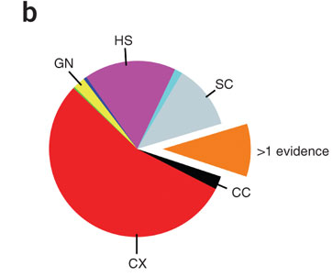
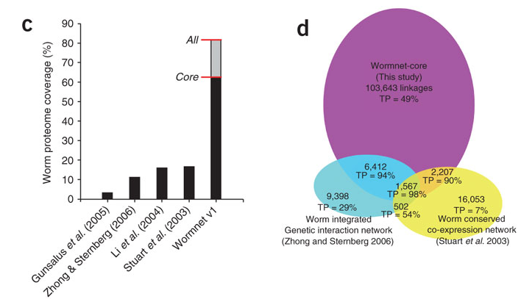
Amazing success
Notes:
The network extends considerably beyond previously described associations: 83,946 links in the core network (74%) neither derive from literature-mined relationships nor overlap with known Gene Ontology pathway relationships.

Slide 9
How does it happen
The network extends considerably beyond previously described associations: 83,946 links in the core network (74%) neither derive from literature-mined relationships nor overlap with known Gene Ontology pathway relationships.

Slide 10
Datasets
expression data from the Stanford Microarray Database
- selected 6 sets encompassing 220 DNA microarray experiments and 635 additional array experiments previously published
- significant correlation between the extent of mRNA co-expression and functional associations between genes
genome-wide yeast two-hybrid interactions between C. elegans proteins and the associated literature-derived protein-protein interactions from the Worm Interactome database
Genetic interactions from WormBase (derived from >1,000 primary publications)
Human protein interactions were collected from existing literature-derived databases, as well as large-scale yeast two-hybrid analysis, then transferred by orthology to C. elegans via orthologs defined using INPARANOID
fly yeast two-hybrid interactions
yeast functional gene network
Interactions were assigned confidence scores before integration
Notes:
Supplementary page 6

Slide 11
Datesets cont’d
comparative genomics linkages from the analysis of 133 genomes (117 bacteria and 16 archaea) using the methods of phylogenetic profiling and gene neighbors.
linkages from co-citation of C. elegans gene names in ~7000 Medline abstracts that included the word “elegans”.

Slide 12
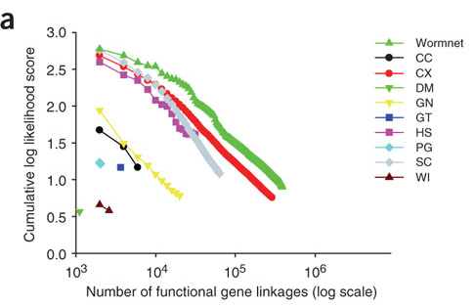
Integration of datasets
Estimation of the extent that each dataset links genes known to share biological functions as determined from Gene Ontology (GO) annotations.
Evidence codes:
CC, co-citation;
CX, co-expression;
DM, fly interolog;
GN, gene neighbor;
GT, genetic interaction; HS, human interolog;
PG, phylogenetic profiles;
SC, yeast associalog;
WI, worm protein interactome version 5.

Slide 13
Common scoring scheme
the log likelihood score (LLS) scheme: the functional coupling between each pair of genes, defined as the likelihood of participating in the same pathway.
where P(L|E) and P(¬L|E) are the frequencies of linkages (L) observed in the given experiment (E) between annotated genes operating in the same pathway and in different pathways, respectively, while P(L) and P(¬L) represent the prior expectations (i.e., the total frequency of linkages between all annotated C. elegans genes operating in the same pathway and operating in different pathways, respectively).
the relative merits of each dataset is used to prior to integration weighted according to their scores

Slide 14
two primary reference pathway sets to evaluate and integrate datasets (training)
The C. elegans Gene Ontology (GO) annotation from WormBase ~ 786,056 gene pairs sharing annotation
gold-standard positive functional linkages, we selected genes sharing GO "biological process" annotation terms from levels 2 through 10 of the GO hierarchy. (with 5 exclusions)
gold-standard negative linkages, we selected pairs of genes from this set that did not share annotation terms
KEGG database annotations ~ 9,406
5,069 pairs shared between the two reference sets
COG
An additional test set (KEGG minus GO) was created by removing all GO pairs from the KEGG set.
Other test sets.
Testing sets

Slide 15
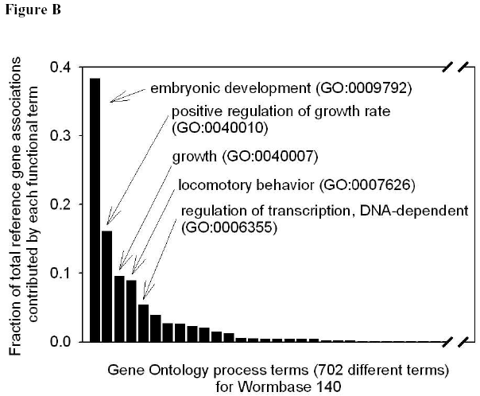
Reference and benchmark sets
The Gene Ontology (GO) annotation from WormBase. Levels 2 ~ 10 from “biological process” hierarchy are used. (exclude top 5 high coverage terms). - 786,056 gene pairs
KEGG database, provides metabolic and regulatory pathway annotations (exclude top 3 most abundant pathway terms). - 9,406 pairs (5,069 common with GO)
COG 12 categories

Slide 16
LLS scheme cont’d
0.632 bootstrapping for all LLS evaluations (claimed to be superior to cross validation especially for small set.)
Each linkage has a probability of 1-1/n of not being sampled, resulting in ~63.2% of the data in the training set and ~36.8% in the test set (7). The overall LLS is the weighted average of results on the two sets, equal to 0.632*LLStest + (1-0.632)*LLStrain, calculated as the average over 10 repeated sampling trials.
Notes:
Unlike cross validation, which uses sampling without replacement for constructing test and training datasets, 0.632 bootstrapping employs sampling with replacement, constructing the training set from data sampled with replacement and the test set from the remaining data that weren’t sampled.

Slide 17
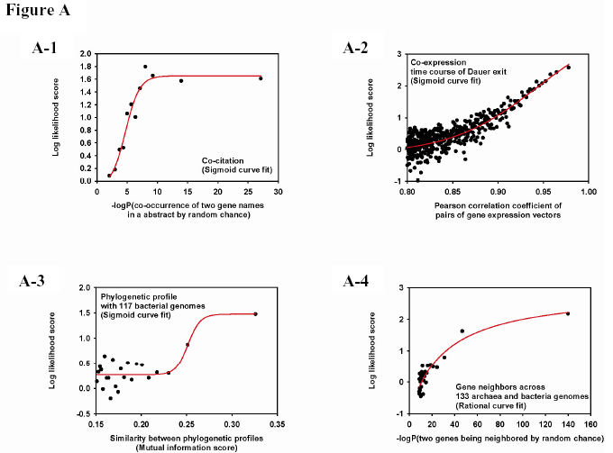
LLS scheme cont’d – regression is used for continuous scores in some datesets
Only positive correlation is used
Bacteria profile performs best
Notes:
For data sets accompanied by intrinsic scores that are continuous (e.g., correlation
coefficients between pairs of gene expression vectors), we ranked gene pairs by the
scores and calculated log likelihood scores for bins of equal numbers of gene pairs.
Those LLSs and the corresponding mean of the data intrinsic scores for each bin were
used to derive regression models mapping the data intrinsic scores to LLS scores, in this
manner generating LLS scores for both annotated and unannotated gene pairs

Slide 18
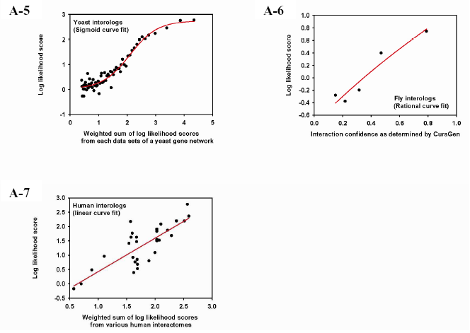

Slide 19
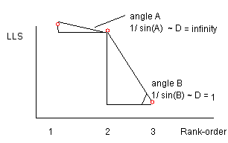
the weighted sum (WS) of individual scores – integrating all data sets
T, representing a LLS threshold for all data sets being integrated.
D, a parameter for the overall degree of independence among the data sets. Determined by the (linear) decay rate of the weight for secondary evidence. It ranges from 1 to +∞ and captures the relative independence of the data sets, low values of D indicating more independence among data sets and higher values indicating less.
i is the order index of the data sets after rank-ordering the n remaining LLS scores descending in magnitude.
D, T are chosen by systematically testing values of D and T in order to maximize overall performance (area under a plot of LLS versus gene pairs incorporated in the network) on the Gene Ontology benchmark, selecting a single value of D and of T for all gene pairs being integrated using these datasets.

Slide 20
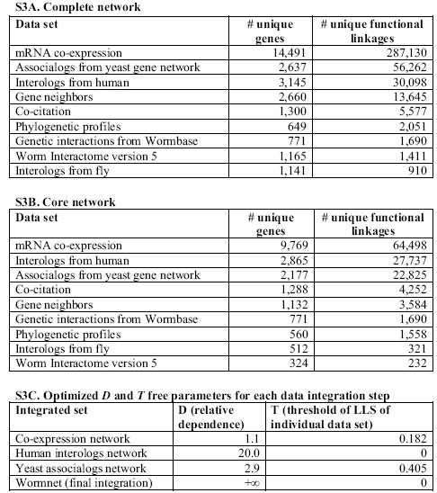
integration
composite
Notes:
Compare with Zhong & sternberg, human interolog, co-citation, gene neighbor, phylogenetic profile, are added.

Slide 21
Final network
The final network has a total of 384,700 linkages between 16,113 C. elegans proteins, covering ~82 % of C. elegans proteome; all gene pairs have a higher likelihood of belonging to the same pathway than random chance. To define a model with high confidence and reasonable proteome coverage, we applied a likelihood threshold, keeping only gene pairs linked with a likelihood of being in the same pathway of at least 1.5 fold better than random chance. Using this threshold, we defined the core network, containing 113,829 linkages for 12,357 worm proteins (~63% of the worm proteome).

Slide 22
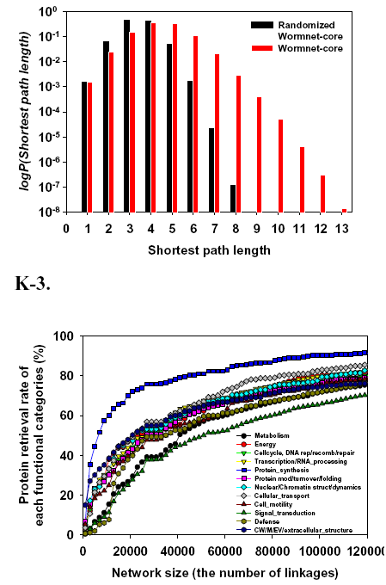
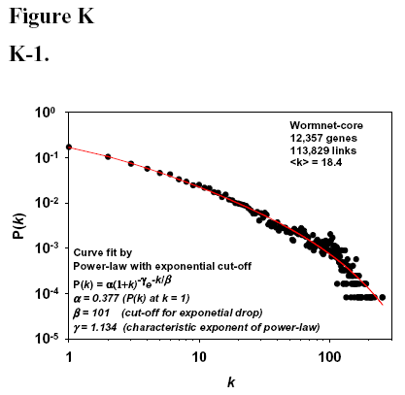
Basics
Notes:
K3 no biase for gene function category

Slide 23
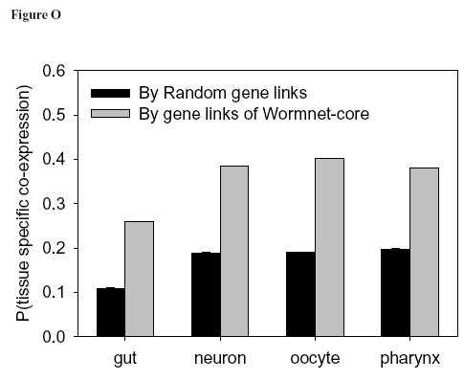
Linkages in Wormnet tend to connect genes expressed in the same tissue.

Slide 24
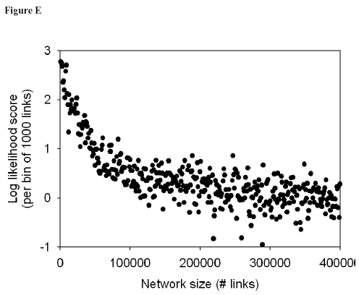
Basic evaluations
Core
all

Slide 25
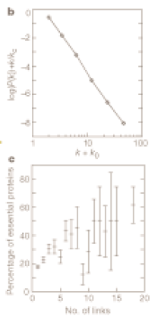
first tested whether the network could predict gene essentiality
B. Excluding yeast-derived linkage (which reported this correlation by barabasi)
A. Correlating to a whole genome RNAi study. (embryonic lethal, sterile, larval lethal, sterile progeny, adult lethal are considered essential.)
After removing all yeast orthologs
C. the subset of 6,924 genes with mouse orthologs. RNAi from mouse embryonic + perinatal lethality is essential.
Barabasi
Pearson r = 0.75

Slide 26
Essentiality of genes appears to ‘diffuse’ across the network.
(Left) Based on RNAi phenotype, we categorized genes into two classes, embryonic lethal (emb) and nonembryonic lethal, and plot the % of genes that are emb at 1, 2, and 3 hops from each emb gene (0 hops corresponds to 100%). We find that the probability of being embryonic
lethal decays with increasing distance from other embryonic lethal genes in the network.
(Right) For the cases where essential genes are linked, we also examined the penetrance of the embryonic lethal RNAi phenotype as it diffuses through the network. We measured the mean % embryonic lethality for lethal genes linked by 1, 2, and 3 hops to a gene with 100% penetrance. The mean penetrance of lethality appears to decay with increasing distance from the 100% penetrant embryonic lethal genes.

Slide 27
Whether A single network can predict diverse phenotypes
'guilt by association' approach
“If genes that share any given loss-of-function phenotype associated tightly together, this would indicate that Wormnet has the capability to identify additional genes sharing loss-of-function phenotypes with previously studied genes.”
And reversely, if tightly linked, weather the partner has similar phenotype.
Notes:
whether we could accurately identify genes with diverse functions ascertained through previous genome-wide RNAi screens

Slide 28
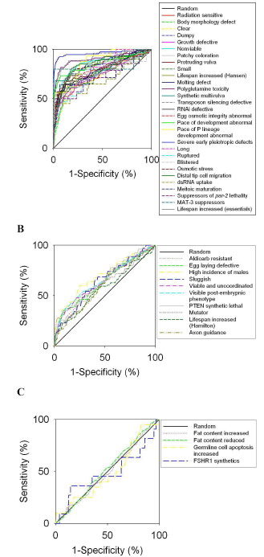
Among the 43 tested phenotypes, we found (A) 29 strongly predictable phenotypes, (B) 10 moderately or weakly predictable phenotypes, and (C) 4 predictable at no better than random levels.
leave-one-out prediction method: For a given phenotype, genes conferring a specific RNAi phenotype as the “seed” set. Each gene in the worm proteome was rank-ordered by the sum of its linkage log likelihood scores to this seed set (omitting each seed gene). FN and FP are calculated as a function of RANK, ROC curve is used to evaluate the performance.
Notes:
Rank is the variable to generate different TP(Y), FP(X) ROC curve.

Slide 29
Genes sharing loss-of-function phenotypes are tightly linked in the network
These results demonstrate that a single gene network can predict effects of gene perturbation for diverse aspects of animal biology, and that it is not essential to construct a specialized subnetwork for each particular process.
Look at the reverse sentence: genes tightly linked in the network are sharing loss-of-function phenotypes.

Slide 30
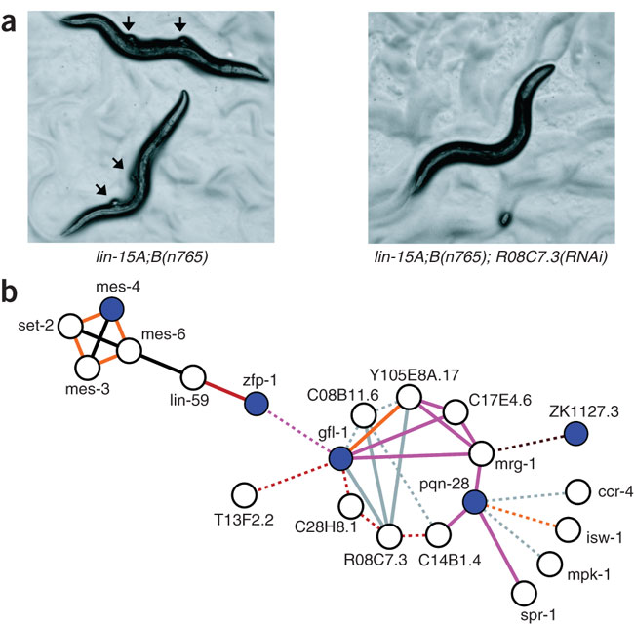
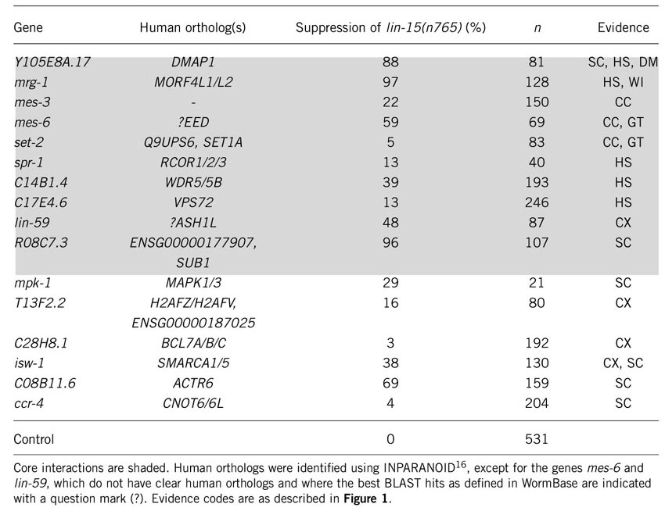
whether we could identify previously unknown genes that modulate pathways relevant to human disease and then experimentally validate these predictions
Lin-15 A;B strain
synMuv A
synMuv B
ectopic vulva
Notes:
10 linked by core links, 6 dashed (non-core). But how strong these links are? 20 time, 5 time, still low.

Slide 31
The dystrophin complex modulates EGF-Ras-MAPK signaling
(b) Inactivation of DAPC components by RNAi can suppress the induction of ectopic vulvae by a gain-of-function Ras/let-60 gene.
(c) Mutations in the dys-1 gene enhance the larval lethal phenotype of let-60(RNAi)
Known: function of EGF signaling is as an inductive signal during vulval development.
The genetic interaction suggests that the DAPC positively regulates EGF signaling during vulva induction.
Notes:
Is it bad or good? Two modules are only linked by 3 links.

Slide 32
usage
the network predicts diverse cellular, developmental and physiological processes with great specificity.
Newly identifies (annotates) relations of gene - pathway by clustered nodes.
Identifies interaction between pathways.

Slide 33
Their future development
Adding more data for the rest ~20% genes
Adding Transcriptional analyses of individual tissues and mutant strains – tissue specificity.
“Seed” set for particular disease to identify candidate genes.
Human network DONE.

Slide 34
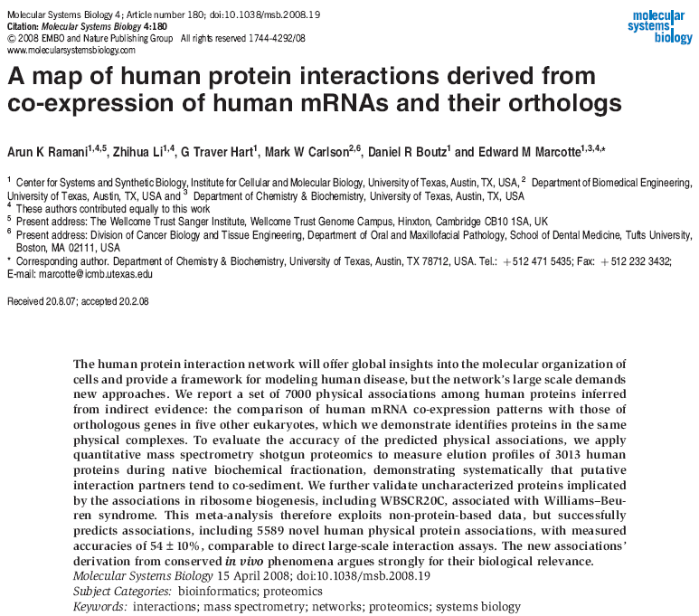
Notes:
Submit a group of mutated genes in a cancer individual, compare the network between individuals.

