Slide 1
Look at the two datasets what are they doing

Slide 2
Network-based classification of breast cancer metastasis
Molecular Systems Biology 3; Article number 140; doi:10.1038/msb4100180

Slide 3
Background
An ongoing challenge is to identify new prognostic markers that are more directly related to disease and that can more accurately predict the risk of metastasis in individual patients.
Marker sets are selected by scoring each individual gene for how well its expression pattern can discriminate between different classes of disease.
~70 gene markers that were 60–70% accurate for prediction of metastasis, rivaling the performance of clinical criteria. Strangely, however, these marker sets shared only three genes in common, with the first set of markers predicting metastasis less successfully when scoring patients from the second study, and vice versa

Slide 4
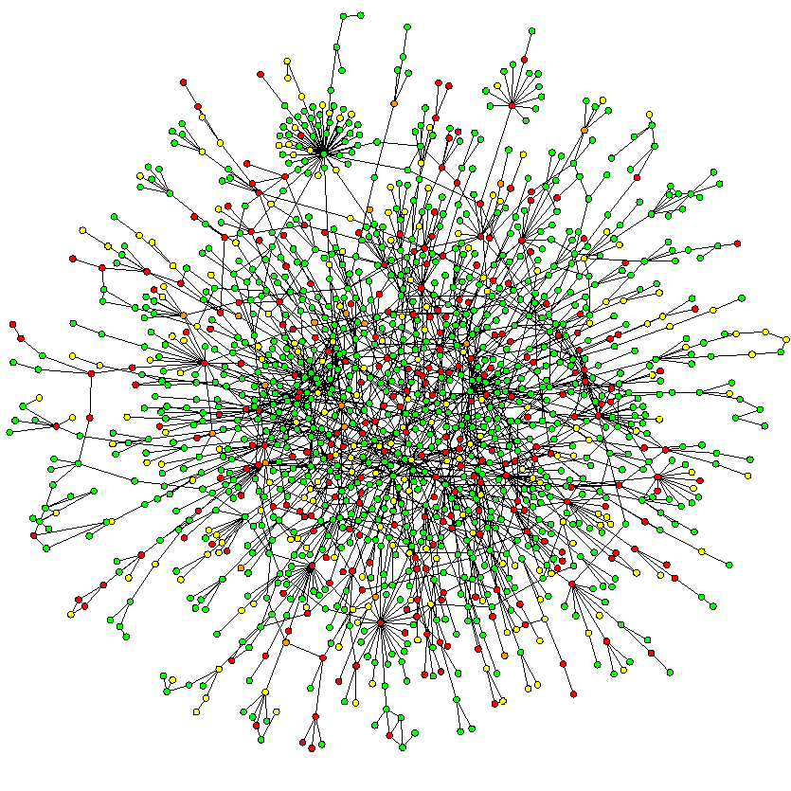

Slide 5
Pathway based idea
many groups have hypothesized that a more effective means of marker identification may be to combine gene expression measurements over groups of genes that fall within common pathways.
However, a remaining hurdle to pathway-based analysis is that the majority of human genes have not yet been assigned to a definitive pathway.

Slide 6
Protein-Network-based approach
The markers in question are not encoded as individual genes or proteins, but as subnetworks of interacting proteins within a larger human protein–protein interaction network.
Advantages:
models of the molecular mechanisms
Known cancer genes interconnecting expression-responsive genes, rather than a mandatory mutation marker
Results are reproducible across cancer cohorts

Slide 7
Summary
overlaid the expression values of each gene on its corresponding protein in the network and searched for subnetworks whose activities across the patients were highly discriminative of metastasis.

Slide 8
Combining and intersecting 2 expression profile studies
‘metastatic’/‘non-metastatic’ patients
78/217 (295) patients in van de Vijver et al (2002)
106/180 (286) in Wang et al (2005)
8141 genes present in both data sets
protein–protein interaction network in use:
a pooled data set comprising 57235 interactions among 11203 proteins, integrated from
Yeast two-hybrid experiments (Rual et al, 2005; Stelzl et al, 2005),
predicted interactions via orthology and
co-citation (Ramani et al, 2005), and curation of the literature

Slide 9
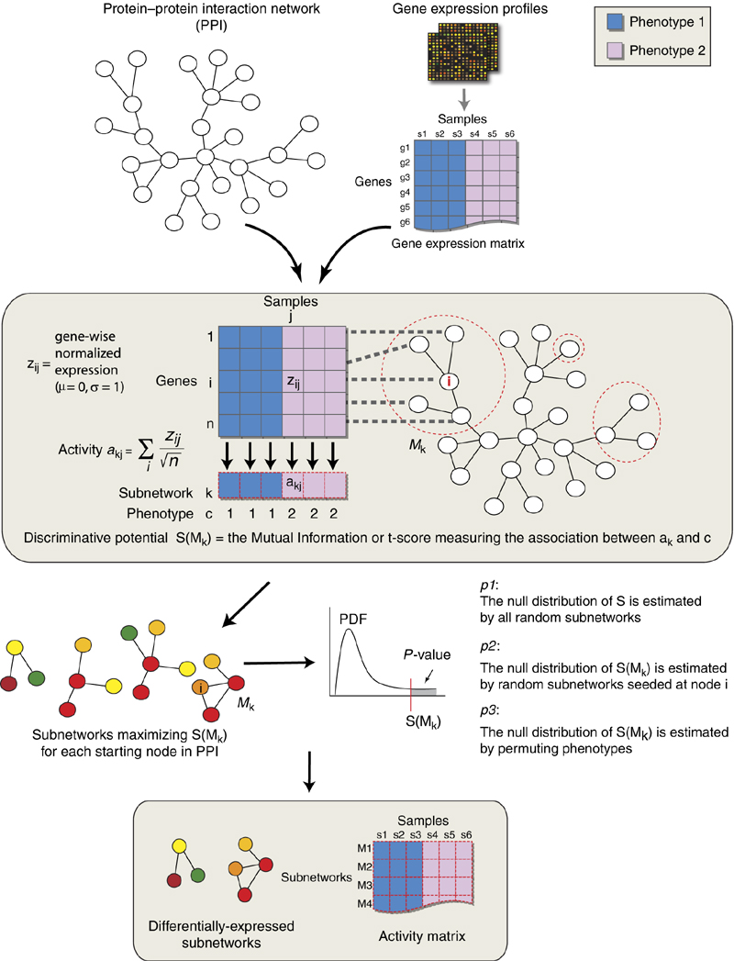
A subnetwork is defined as a gene set that induces a single connected
component in the protein–protein interaction network. (some genes lost)
P1<0.05, P2<0.05, and P3<0.00005,
Notes:
Protein–protein interaction networks are used to assign sets of genes to discrete subnetworks. Gene expression profiles of tissue samples drawn from each type of cancer (i.e., metastatic or non-metastatic) are transformed into a 'subnetwork activity matrix'. For a given subnetwork Mk in the interaction network, the activity is a combined z-score derived from the expression of its individual genes. After overlaying the expression vector of each gene on its corresponding protein in the interaction network, subnetworks with discriminative activities are found via a greedy search. Significant subnetworks are selected based on null distributions estimated from permuted subnetworks (see Materials and methods). Subnetworks are then used to identify disease genes, and the subnetwork activity matrix is also used to train a classifier.

Slide 10
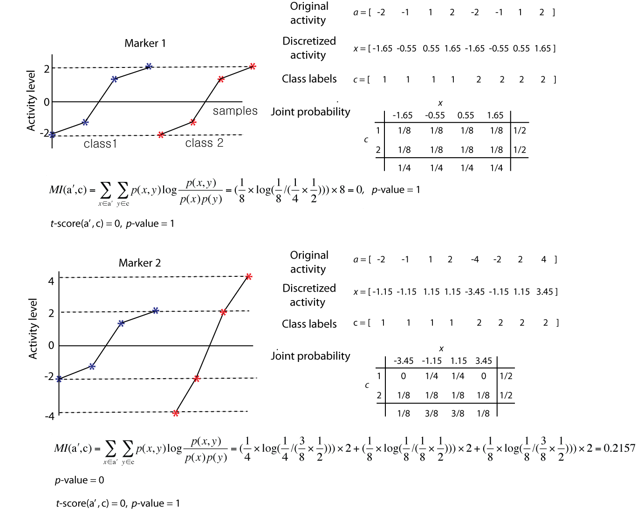
Mutual information of two random variables is a quantity that measures the mutual dependence of the two variables.
To derive a’ from a, activity levels are
discretized intob
log 2(# of samples) +1 =9 equally spaced bins
(Tourassi et al, 2001).

Slide 11
Searching for significant subnetworks
Given the discriminative score function S, a greedy search is performed to identify subnetworks within the protein–protein interaction network for which the scores are locally maximal.
Procedure:
Candidate subnetworks are seeded with a single protein and iteratively expanded.
At each iteration, the search considers addition of a protein from the neighbors of proteins in the current subnetwork and within a specified network distance d (=2) from the seed.
The addition that yields the maximal score increase is adopted; the search stops when no addition increases the score over a specified improvement rate r (=0.05).

Slide 12
Subnetwork markers
A total of 149 and 243 discriminative subnetworks were identified in van de Vijver et al (2002) and Wang et al (2005) data sets (consisting of 618 and 906 genes, respectively, and based on a panel of three separate tests for statistical significance).
Approximately 88% of the 149 subnetworks identified from van de Vijver et al (2002) had higher activity levels in metastatic breast tumors than in non-metastatic ones, whereas the 243 subnetworks identified from Wang et al (2005) were split roughly equally in their direction of activity change (124 versus 119).

Slide 13
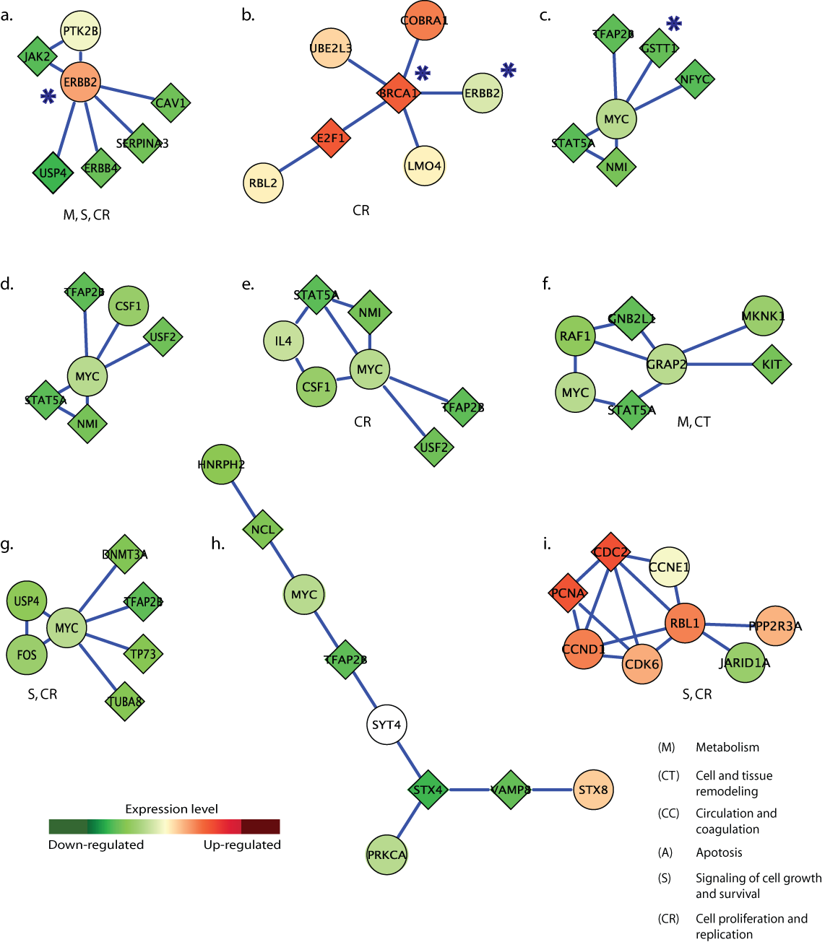
a diamond is significantly differentially-expressed (p < 0.05 from a two-tailed t-test) while a circle is not.

Slide 14
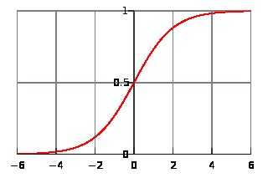
Logistic regression model
Subnetwork markers or individual gene markers are selected using the whole first data set (van de Vijver et al, 2002) and then tested on the second data set (Wang et al, 2005); or vice versa.
To measure unbiased classification performance, the patient samples in the second data set are divided into five subsets of equal size: three subsets are used as the training set to build the classifier using markers from the first data set, one subset is used as the validation set and the other subset is used as the test set.
The P-value of discriminative power to classify training samples (P3) is used to rank markers (subnetworks or genes), after which the logistic regression model is built by adding markers sequentially in increasing order of P-value. The number of markers used in the classifier is optimized by evaluating its area under ROC curve (AUC; see Swets et al, 2000 for details) on the validation set. The final classification performance is reported as the AUC on the test set using the optimized classifier.

Slide 15
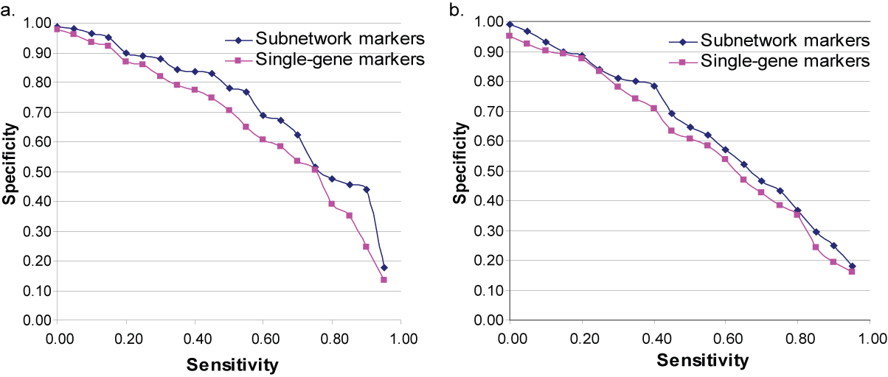
Performance and reproducibility
Notes:
Fig 2 b is within dataset and 5 fold cross validation; lower fig S2 is cross dataset.
At 90% sensitivity, the subnetwork markers from van de
Vijver et al (2002) achieved 48.8% accuracy in classifying
samples in Wang et al (2005), and 55.8% accuracy for the
reciprocal test. The single-gene markers achieved 45.3 and
41.5% accuracies, respectively.

Slide 16
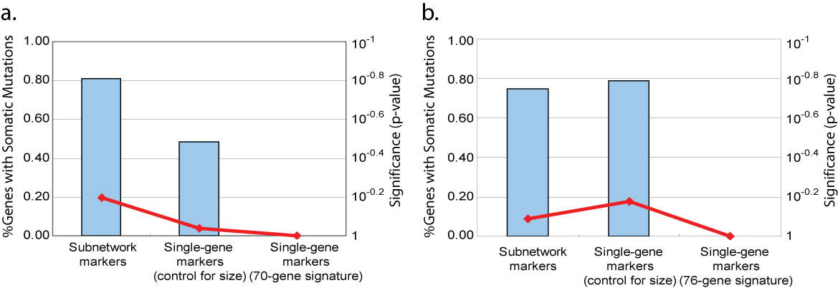
Related to somatic mutatoin
Supplemental Figure S4. Detection of 71 genes with somatic mutations associated with breast cancer in Sjoblom et al.. The enrichment of disease genes is shown for subnetworks selected from van de Vijver et al. (a) or Wang et al. (b). Blue bars chart the percentage of disease genes on the left axis; the red line charts the hypergeometric p-values of enrichment on the right axis.

Slide 17
Improvement
Not only expression profile.
Activity score averaging? Better transformation.
More data like WTCCC.

