Slide 1
A survey of visualization tools for biological network analysis
Georgios A Pavlopoulos , Anna-Lynn Wegener and Reinhard Schneider
Structural and Computational Biology Unit, EMBL, Meyerhofstrasse 1, Heidelberg, Germany

Slide 2
Motivation
Evolvement and expansion of bioinformatics:
Growing quantities of data obtained by the newly developed technologies
Exponentially growing bio-medical scientific literature
Growing complexity of data
Need to integrate heterogeneous types of data

Slide 3
Solution
An interactive visual representation of information together with data analysis techniques is often the method of choice to simplify the interpretation of data.
Graphs, as specified by graph theory, represent biological interactions in the form of extensive networks consisting of vertices, denoting nodes of individual bio-entities, and edges, describing connections between vertices.

Slide 4
Solution
Biological systems are complex and interwoven and in most cases single-line connections are insufficient to capture the whole range of information contained in a network, because components are often linked by more than one type of relationship.
In such cases visualization tools based on multi-edged networks offer the possibility to link two vertices by multiple edges, every edge having a different meaning and information value.

Slide 5
Solution
The goal of all presented tools is to find patterns and structures that remain hidden in the raw unstructured datasets.
The survey covers tools invented mainly over the past five years.
Criteria for the assessment of visualization tools include:
- power
- efficiency and quality of network visualizations produced
- the compatibility with other tools and data sources
- the analytical functionalities offered,
- limitations in terms of data quantity
- broad applicability
- user-friendliness

Slide 6
Medusa [Hooper SD, Bork P, 2005]
Java application available also in a form of an applet
This is an open source product
Visualization is based on the Fruchterman-Reingold algorithm.
2D visualization of small networks with up to a few hundred nodes and edges.
Allows more than one connection between two bioentities
Supports weighted graphs
Has its own test files format that is not compatible with other viz. tools
Input file allows the user to annotate each node
Highly interactive
Allows selection and analysis of subsets of nodes
Supports regular expressions text search for nodes
Strength: Medusa is optimized for protein-protein interaction data as taken from STRING or protein-chemical and chemical-chemical interactions as taken from STITCH.

Slide 7
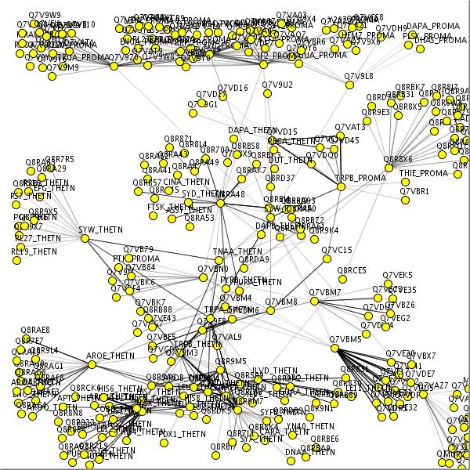
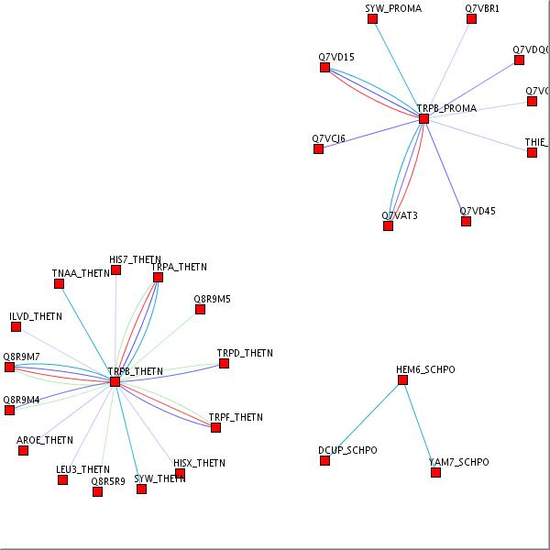
Medusa
Website: http://coot.embl.de/medusa/
Fig 1 Fig 2

Slide 8
Cytoscape [Shannon et al., 2003]
Standalone Java application. It is an open source project under LGPL license
provides 2D representations
Is suitable for large-scale network analysis with hundredth thousands of nodes and edges
Can support directed, undirected and weighted graphs
Comes with powerful visual styles that allow the user to change the properties of nodes or edges
Provides a variety of layout algorithms including cyclic and spring-embedded layouts.
Expression data can be mapped as node color, label, border thickness, or border color
Comes with various data parsers or filters that make it compatible with other tools
Supported formats are: SIF, GML, XGMML, BioPAX, PSI-MI, SBML, OBO, as well as, mRNA expression profiles, gene functional annotations from the Gene Ontology (GO) and KEGG
Highly interactive and the user can zoom in or out and browse the network
Efficient in comparisons of networks between each other
Comes with efficient network filtering capabilities
incorporates statistical analysis of the network and it makes it easy to cluster or detect highly interconnected regions

Slide 9
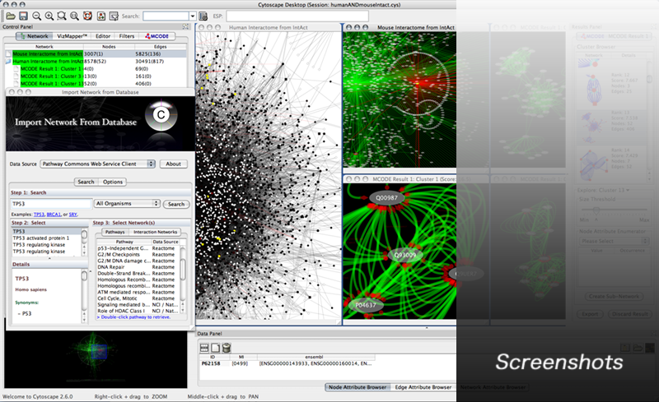
Cytoscape
Website: http://www.cytoscape.org/

Slide 10
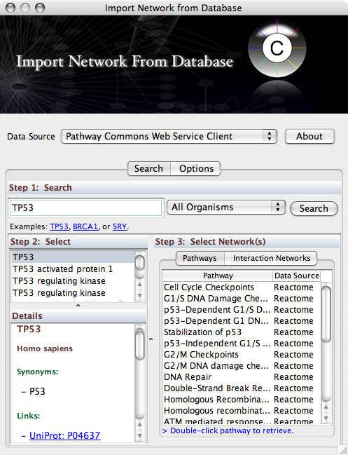
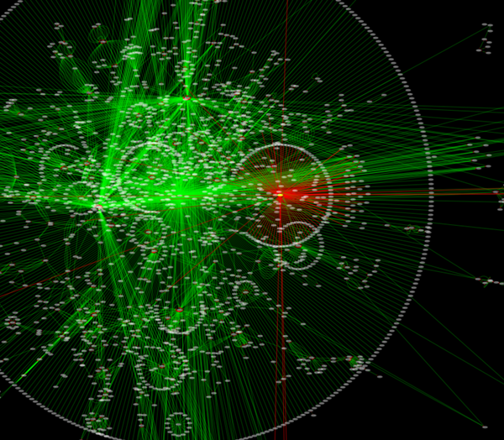
Cytoscape

Slide 11
BioLayout Express3D [Freeman TC et al., 2003]
Written in Java 1.5 and it uses the JOGL system for OpenGL rendering
Released under the GNU Public License (GPL).
Requires medium or high range graphics card to run
Provides visualization and clustering of large scale networks in both 3D and 2D
Supports both unweighted and weighted graphs together with edge annotation of pairwise relationships
Employs the Fruchterman-Rheingold layout algorithm for 2D and 3D graph positioning and display of the network
Variety of colour schemes render the network more informative and clusters can be easier visualized
The size of networks that can be processed is limited
Is compatible with Cytoscape and it supports layout, expression, yEd GraphML and sif file formats
Has a simple input file format
Highly interactive and the user can switch between 2D and 3D representations
Users can move around the current view, zoom in/out, rotate or move the network
Uses Markov Clustering algorithm (MCL) for clustering analysis
Strength
BioLayout Express^{3D} offers different analytical approaches to microarray data analysis.

Slide 12
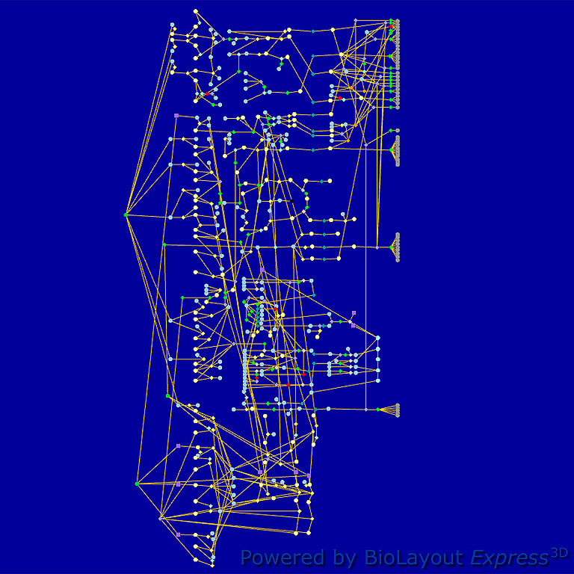
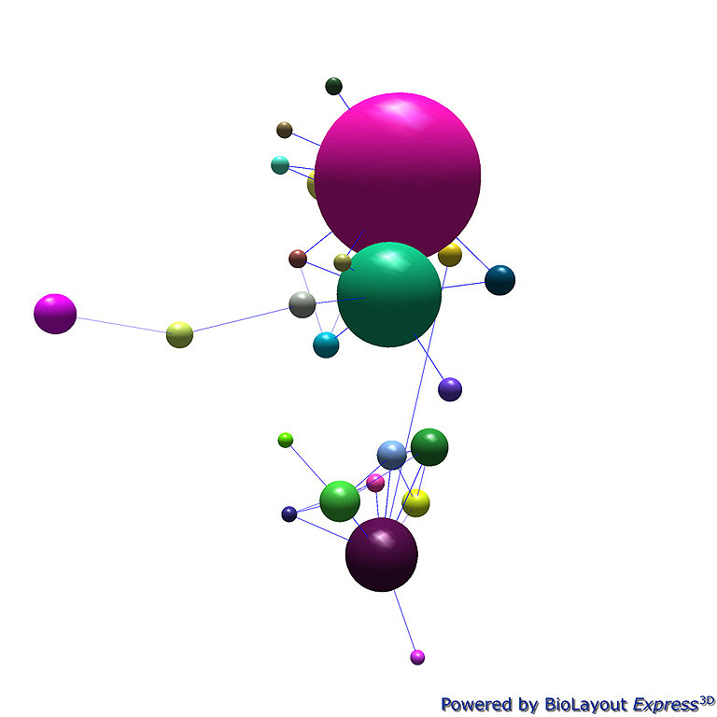
BioLayout Express3D
Website: http://www.biolayout.org/
Notes:
Figure one is Macrophage Activation Pathways
Figure 2 is HCMV infection, collapsed

Slide 13
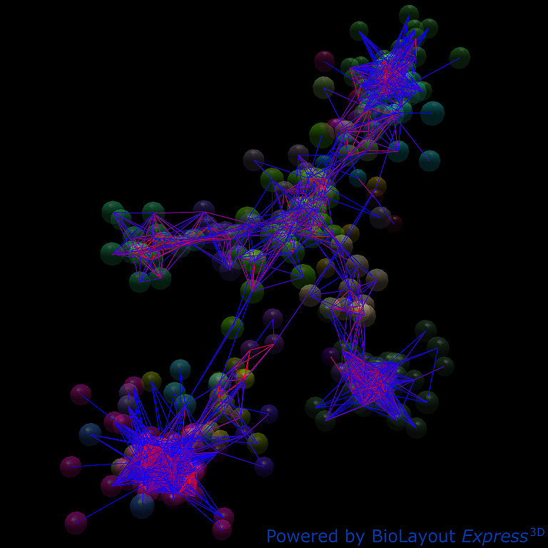
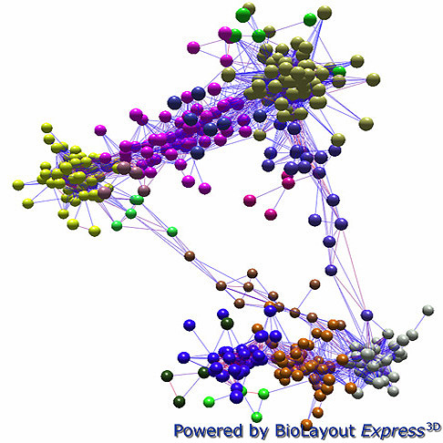
BioLayout Express3D
Notes:
Figure 1: Network GI specific genes
Figure 2: Expression clusters with transparent node option

Slide 14
Osprey [Breitkreutz et al., 2003]
Standalone application running under a wide range of platforms
can be licensed for non commercial use and but source code is currently not available
Provides 2D representations of directed, undirected and weighted networks
provides various layout options and ways to arrange nodes in various geometric distributions
Inefficient for large scale network analysis
The layouts range from the relax algorithm over a simple circular layout to a more advanced Dual Spoked Ring layout that displays up to 1500 – 2000 nodes in a easily manageable format
Data can be loaded into the tool either using different text formats or by connecting directly to several databases, such as the BioGRID or GRID (General Repository of Interaction Datasets) database,also, has its own format
Osprey networks can be saved in SVG, PNG and JPG format
Provides several features for functional assessment and comparative analysis of different networks together with network and connectivity filters and dataset superimposing
Has the ability to cluster genes by GO Processes
Network filters can extract biological information
Strength: The ability to incorporate new interactions into an already existing network

Slide 15
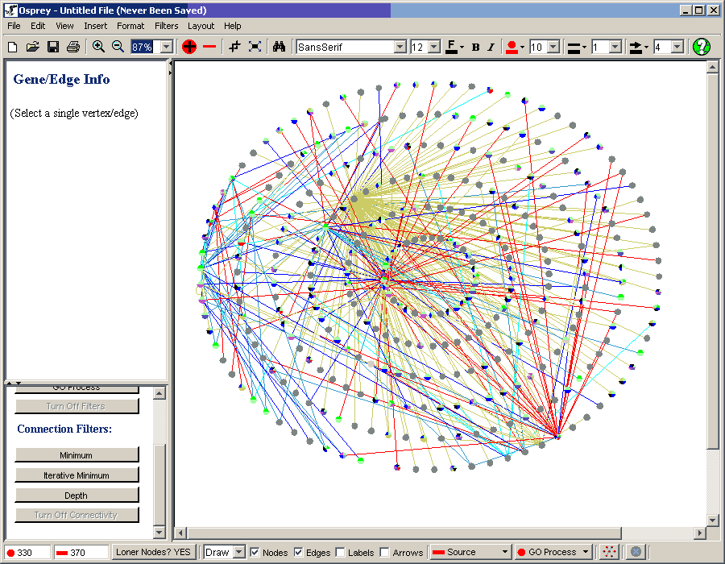
Osprey
Website: http://biodata.mshri.on.ca/osprey/servlet/Index

Slide 16
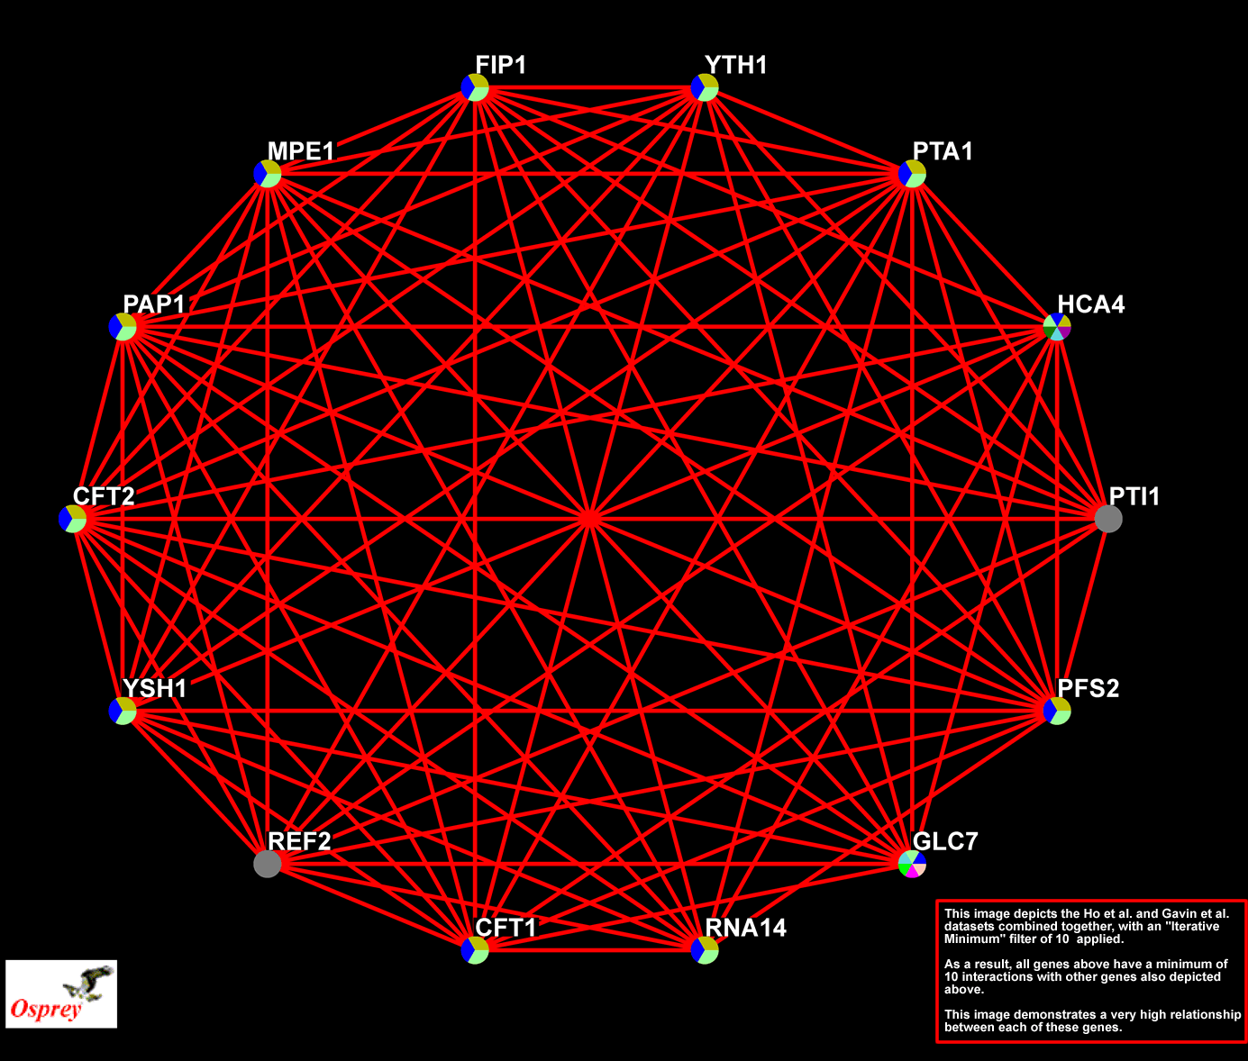
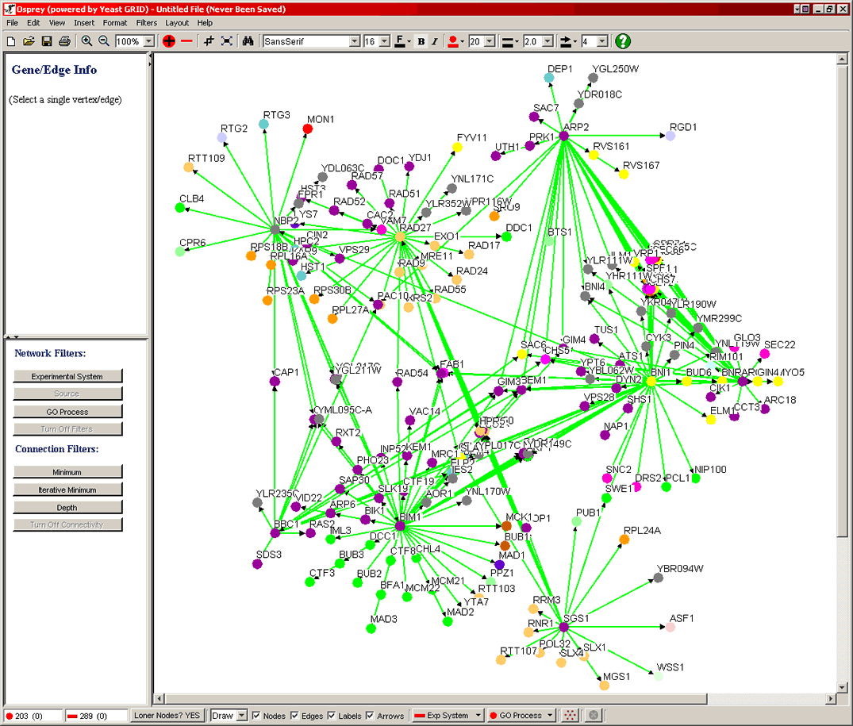
Osprey

Slide 17
ProViz [Iragne et al., 2005]
standalone open source application under the GPL license
Visualization in both 2D and pseudo-3D display support to render data
can manipulate single graphs in large-scale datasets with millions of nodes or connections
predominantly relies on the GEM force based graph layout algorithm which facilitates the identification of key points in a network of interactions
offers a circular and a hierarchical layout, which improve the detection of metabolic pathways or gene regulation networks in large datasets
Ideal to gain a first overview of networks because it allows fast navigation through graphs
Graphs are saved and loaded in Tulip, PSI-MI and IntAct formats
Networks can also be exported in PNG format
Subgraphs that are produced by selection, filtering or clustering methods and can be automatically organized into views
It is possible to annotate each node and each edge with comments
Strength: protein – protein interaction networks and their analysis using arbitrary properties, like for example annotations or taxonomic identifier. Its plug-in architecture allows a diversification of function according to the user's needs.

Slide 18
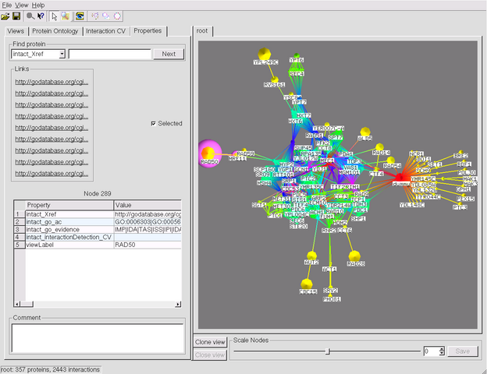
ProViz
Website: http://cbi.labri.fr/eng/proviz.htm

Slide 19
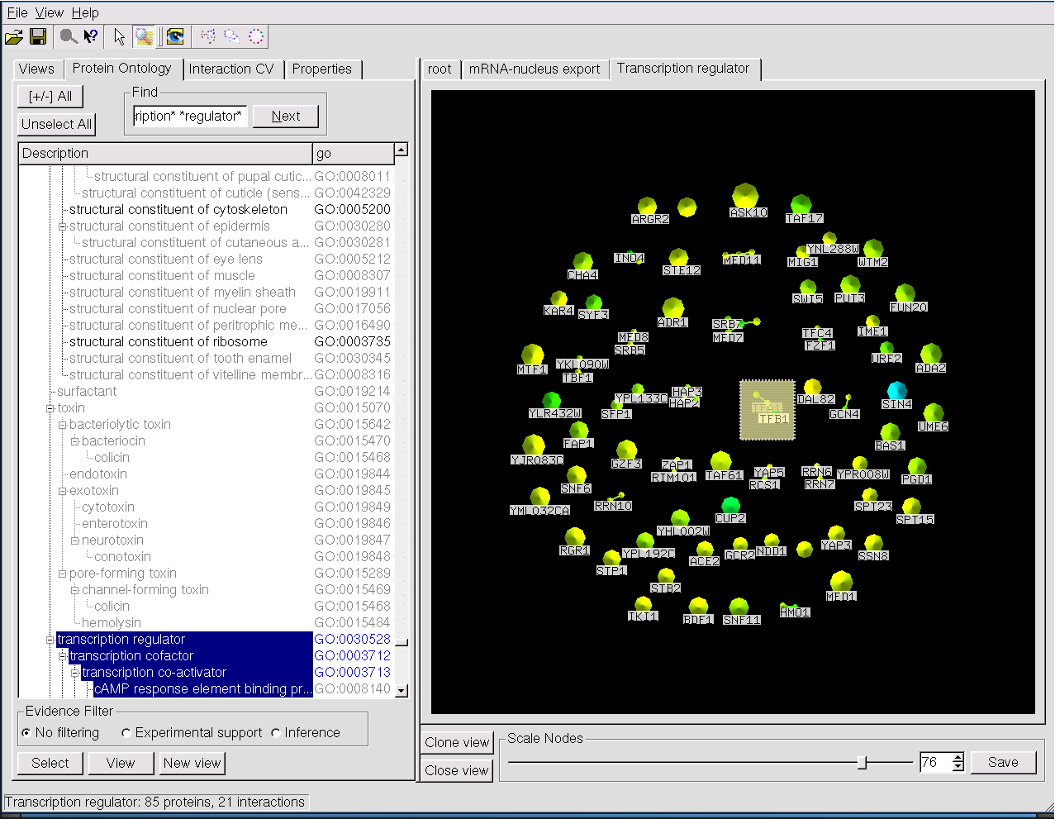
ProViz

Slide 20
Ondex [Köhler J et al., 2003, 2004, 2006]
A standalone freely available open source application
Provides 2D representations of directed, undirected and weighted networks
Can handle large scale networks of hundred thousands of nodes and edges.
Supports bidirectional connections, which are represented as curves
Data may be imported through a number of 'parsers' for public-domain and other databases, such as:
TRANSFAC, TRANSPATH, CHEBI, Gene Ontology, KEGG, Drastic, Enzyme Nomenclature-ExPASy, Pathway Tools , Pathway Genomes (PGDBs), Plant Ontology, and Medical Subject Headings Vocabulary – MeSH
Graph objects can be exported to Cell Illustrator and XML formats or saved as ONDEX XML or an XGMML form
Allows graph modifications according to some selected rules.
A KnockOutFilter is used to determine the most important nodes at any given level
A powerful filter is available to import microarray expression level data to globally analyze the relations between the different genes being expressed.
Strength: Ondex main strength is the ability to combine heterogeneous data types into one network. It is suitable for text mining, sequence and data integration analysis.
Notes:
different types of data are separated by placing them in different disks-circles interconnected between each other

Slide 21
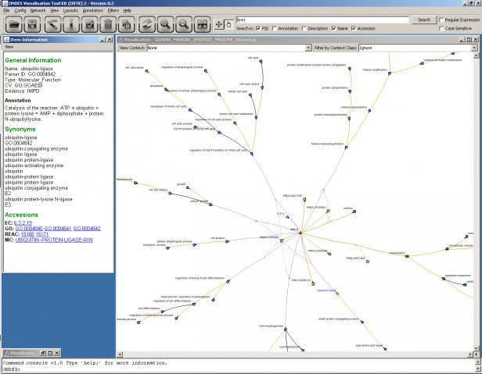
Ondex
Website: http://ondex.sourceforge.net/
Notes:
Screenshot: Protein annotated to the Gene Ontology

Slide 22
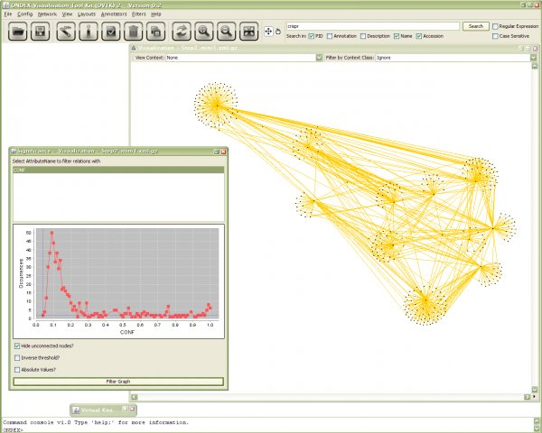
Ondex
Notes:
Screenshot: Filtering a PPI network according to confidence values

Slide 23
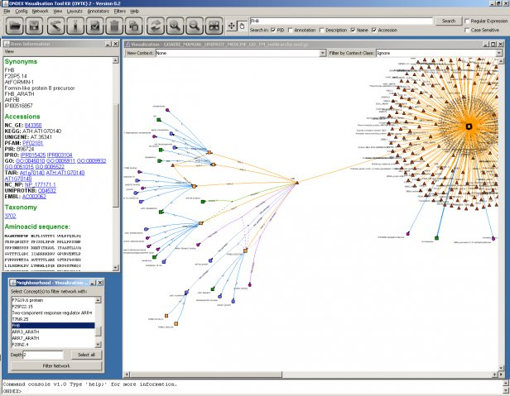
Ondex
Notes:
Screenshot: FH8 protein with manual and text mining based GO annotations

Slide 24
PATIKA (Pathway Analysis Tools for Integration and Knowledge Acquisition) [Demir et al., 2002]
A web based non-open source application publicly available for non-commercial use. It has its own license
Provides 2D representations of single or directed graphs.
No limitations regarding the size of the graphs
Offers an intuitive and widely accepted representation for cellular processes using directed graphs where nodes correspond to molecules and edges correspond to interactions between them
The implemented variety of layout algorithms is rather limited
Is able to support bipartite graph of states and transitions
Integrates data from several sources, including Entrez Gene, UniProt, PubChem, GO, IntAct, HPRD, and Reactome.
Query results can be saved in XML format or exported as common picture formats.
The user can connect to the server and query the database to construct the desired pathway
Pathways are created on the fly, and drawn automatically
User can change/manipulate the pathways
Strength: integrated software environment designed to provide researchers a complete solution for modeling and analyzing cellular processes. It is one of the few tools that allows to visualize transitions efficiently.
Notes:
It represents different types of edges: product edges, where the source and target nodes of a product edge define the transition and a product of this transition, activator edges, where the source and target nodes of an activator edge define the activating state and the transition that is activated by this state, inhibitor edges where the source and target nodes of an activator edge define the inhibiting state and the transition that is inhibited by this state and substrate edges where the target and source nodes of a substrate edge define the transition and a substrate of this transition, respectively.

Slide 25
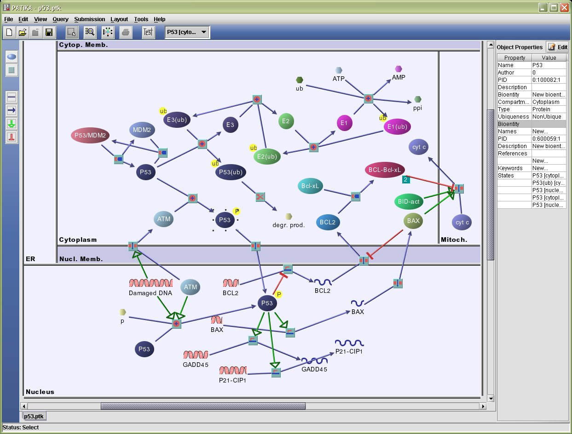
PATIKA
Website: http://www.patika.org/
Notes:
p53 pathway

Slide 26
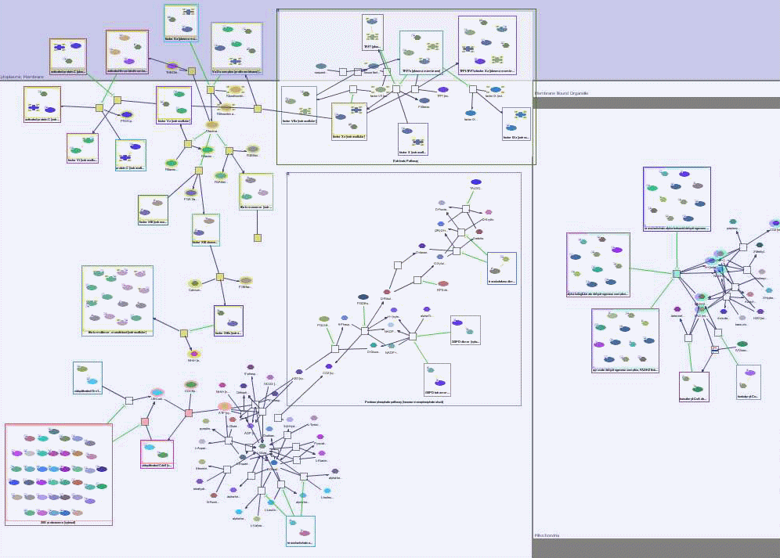
PATIKA
Notes:
Sample layouts produced by PATIKAweb's

Slide 27
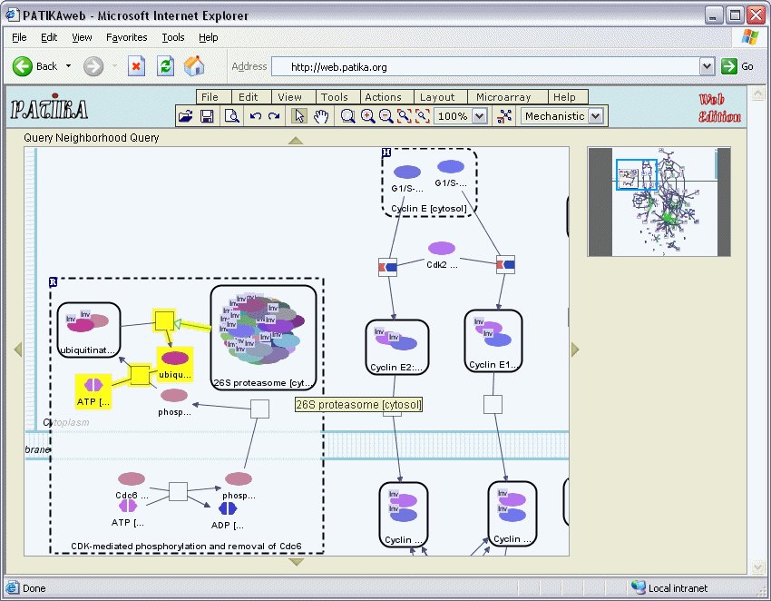
PATIKA

Slide 28
PIVOT [Nir Orlev RS, Yosef Shiloh, 2003]
A Java application, free for academics. It comes with its own license agreement
Projects everything in 2D and it uses single non directed lines to show relationships between bioentities
Not limited to the size of data it can present
The variety of incorporated layout algorithms is limited, but PIVOT employs specific layout algorithms for visualizing families
Configured to work with proteins from four different species (human, yeast, drosophila and mouse), present functional annotations, identification of homologs from the four species, and links to external web information pages
The protein data are stored in an MS-Access file
Can expand the network to display all proteins up to a specified distance, detect t he shortest path of interactions or unfold the relationships among "distant" proteins, which respond similarly under a experiment's conditions
Identifies dense areas of the map
Rich in features that help the users navigate and interpret the interactions map
Strength: best suited for visualizing protein-protein interactions and identifying relationships between them

Slide 29
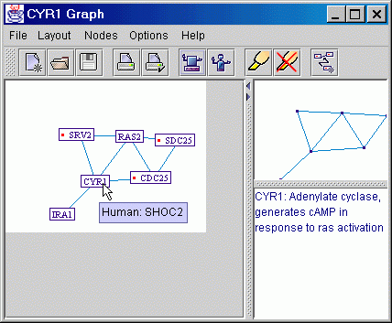
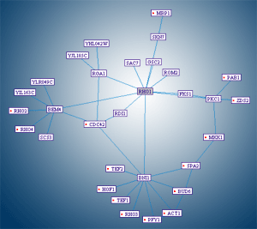
PIVOT
Website: http://acgt.cs.tau.ac.il/pivot/

Slide 30
Pajek [Batagelj V, Mrvar A, 1998]
A standalone application, not an open source application but is free for non-commercial use
Runs under Windows OS only
offers 2D representations and pseudo3d representations and supports single, directed and weighted graphs
Is suitable for large scale networks with thousands or even million of nodes and vertices
Comes with a great variety of layout options
Can separate data into layers, which allows the display of hierarchical relationships
Can handle dynamic graphs and reveal how networks change over time
Comes with its own input file format, not compatible with commonly used XML formats
The status of the network can be saved or information exported in EPS, SVG, X3D and VRML formats
Highly interactive and incorporates many clustering methods
Supports abstraction by decomposition of a large network into several smaller networks
can detect clusters in the network
Strength: main strength is the variety of layout algorithms which greatly facilitate exploration and pattern identification within networks.
Notes:
comes with a great variety of layout options like circular layout using partitions, circular layout using permutation or circular layout using random coordinates layout algorithms. Direct forcing and energy free layout algorithms , such as the Kimura-Kawai and Fruchterman-Reingold are also included

Slide 31
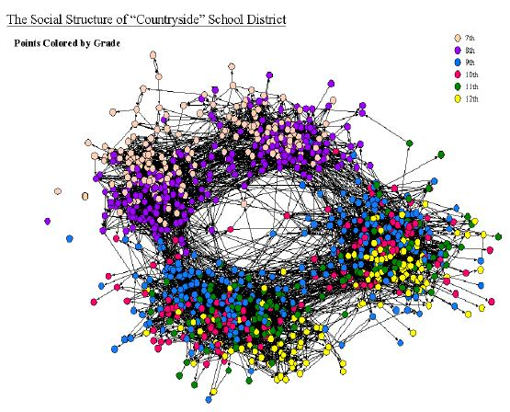
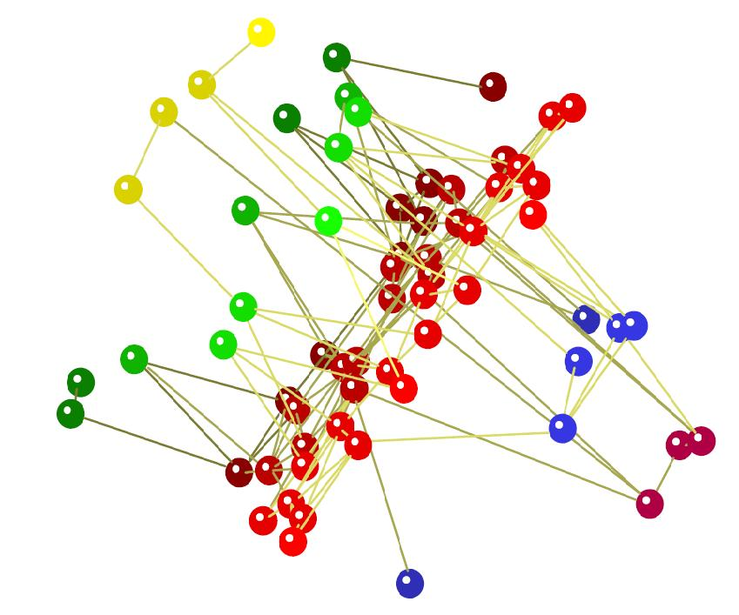
Pajek
Website: http://pajek.imfm.si/doku.php?id=pajek
Pseudo 3D network

Slide 32
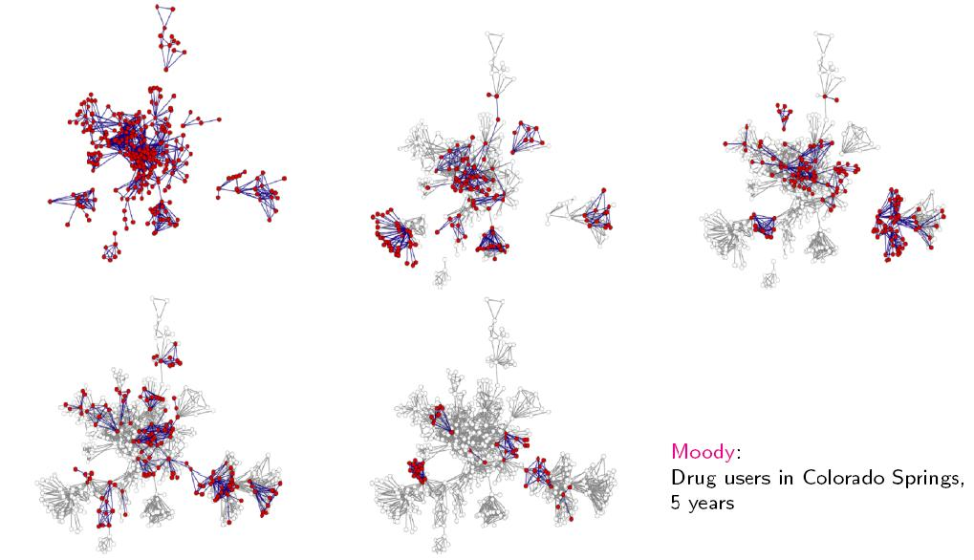
Pajek
Notes:
Temporal network based on presence and on events

Slide 33
Summary
The field of data visualization currently faces three major challenges:
Ever increasing quantity of data to be visualized and analyzed
Integration of heterogeneous data
The representation of multiple connections between nodes with heterogeneous biological meanings
The survey shows, each visualization tool has specific features and thus the tools vary in how they address the outlined challenges.

Slide 34
Standard network file formats
One of the most common and appropriate data visualization format is XML
Advantages:
Readable by humans and computers
stores information in the form of hierarchical tree structures, which allows fast and efficient searching by humans as well as machines
platform-independent text-based format, which supports Unicode and is based on international standards
Forward and backward compatibility which are easy to maintain
Disadvantages:
Inherent redundancy may affect application efficiency due to higher storage
Transmission and processing costs

Slide 35
Standard network file formats
The following is the list of the most widely used file formats and standard languages in bioinformatics and chemoinformatics, most of which are based on XML, or very XML-like:
BioPAX - a collaborative effort to create a computer readable data exchange format for biological data. BioPAX is the most expressive language and is based on a rich hierarchy, which as a trade-off can result in a high degree of computational complexity.
SBML - is a machine-readable format for describing qualitative and quantitative models of biochemical networks. Currently, focuses on models for the analysis and simulation of basic biochemical networks.
PSI-MI - is a machine readable format intended for the exchange, comparison and verification of proteomics data. The main focus is the definition of molecular interactions such as protein-protein interactions

Slide 36
Standard network file formats
CML - is a language mainly developed to describe chemical concepts and information about molecules, reactions, spectra and analytical data, computational chemistry, chemical crystallography and materials.
CellML - is an XML-like machine-readable language mainly developed for the exchange of computer-based mathematical models
RDF - is a language for the representation of information about resources on the World Wide Web. Since the World Wide Web moves towards semantic web structures, RDF was designed as a machine-readable XML-like language that describes networks.

Slide 37
Goals for future generation visualization tools
• Visualization should be able to load and save data using worldwide standard file formats.
• Incorporation of appropriate statistical analysis of the networks.
• Algorithms that allow comparative analysis of different networks.
• Implementation of libraries and services that allow layout algorithms to run in distant powerful computers.
• Efficient layout algorithms that are able to use multi-core CPU technology.
• Algorithms that implement rendering and graphical calculations in GPU.
• Expansion of layout algorithms into 3D space especially for the visualization of pathway or heterogeneous data.
• Visualization of the network behavior and its changes over time. Such animations are currently possible using Flash technologies.

Slide 38
Supplemental data
The database STRING (‘Search Tool for the Retrieval of Interacting Genes/Proteins’) aims to collect, predict and unify most types of protein–protein associations, including direct and indirect associations.
STITCH (‘search tool for interactions of chemicals’) integrates information about interactions from metabolic pathways, crystal structures, binding experiments and drug–target relationships.

Slide 39
Supplemental data
FDP (Force Directed Placement) - spring embedding algorithms can be used to sort randomly placed nodes into a desirable layout that satisfies the aesthetics for visual presentation. FDP (Battista et al., 1984) views nodes as physical bodies and edges as springs connected to the nodes providing forces between them. Nodes move according to the forces on them until a local energy minimum is achieved. In addition to the imaginary springs, other forces (gravitation, electrical, etc.) can be added to the system in order to produce different effects

Slide 40
Supplemental data
The Fruchterman-Reingold Algorithm is a force-directed layout algorithm.
This algorithm is useful for visualizing very large undirected networks. It guarantees that topologically near nodes are placed in the same vicinity, and far nodes are placed far from each other. An overall layout is satisfying , however there will be deficiencies in some local areas of the graph. This can be improved by some manipulations. In this algorithm, the sum of the force vectors determines which direction a node should move. When the energy of the system is minimized, the nodes stop moving and the system reaches it's equilibrium state. A "global temperature" controls the step width of node movements and the algorithm's termination. The step width is proportional to the temperature, so if the temperature is hot, the nodes move faster
Notes:
The idea of a force directed layout algorithm is to consider a force between any two nodes. In this algorithm, the nodes are represented by steel rings and the edges are springs between them. The attractive force is analogous to the spring force and the repulsive force is analogous to the electrical force. The basic idea is to minimize the energy of the system by moving the nodes and changing the forces between them.
This temperature is the same for all nodes, and cools down at each iteration. Once the nodes stop moving, the system terminates.
From (https://nwb.slis.indiana.edu/community/?n=VisualizeData.Fruchterman-Rheingold)

Slide 41
Supplemental data
The Kamada-Kawai Algorithm is a force directed layout algorithm. The idea in general is the same as for previous algorithm: the nodes are represented by steel rings and the edges are springs between them. The basic idea is to minimize the energy of the system by moving the nodes and changing the forces between them. The energy minimization in this algorithm is achieved by obtaining the derivative of the force equations. This algorithm achieves faster convergence and can be used to layout networks of all sizes. However, to obtain an aesthetically pleasing layout it sometimes becomes necessary to use the Fruchterman-Reingold algorithm after the Kamada-Kawai generates an approximate layout.
Notes:
At the minimum energy, the derivatives of the force equation are zero. However, these equations are not independent and therefore cannot be independently brought to zero. So only the node which has the maximum gradient value is moved. This process is continued until the total energy is minimized.

